Slide 1
Autoencoders.

Slide 2
Autoencoders are an unsupervised learning technique
Autoencoders leverage neural networks for representation learning.
Autoencoders introduce a bottleneck which forces a compressed knowledge representation of the original input.
The idea is to capture a structure in the data if one exists in the bottleneck. Once identified, the underlying structure can be used for other things like anomaly detection.

Slide 3
First, we take an unlabeled dataset and attempt to reconstruct the original (x) by obtaining its reconstruction(x^). This network can be trained by minimizing the reconstruction error.
As the name implies, the reconstruction error represents the difference between the original and the reconstruction.
Note that the reconstruction occurs through a bottleneck.
A bottleneck constrains the amount of information that can traverse the full network, forcing a learned compression of the input data.

Slide 4
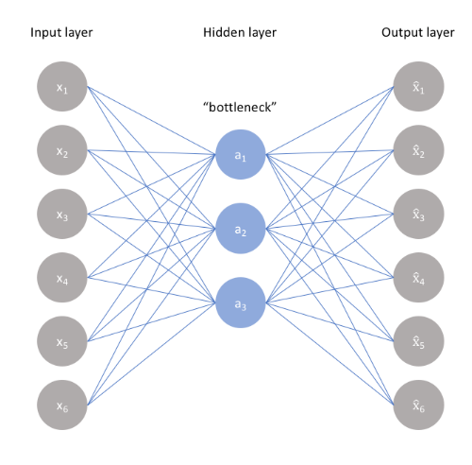

Slide 5
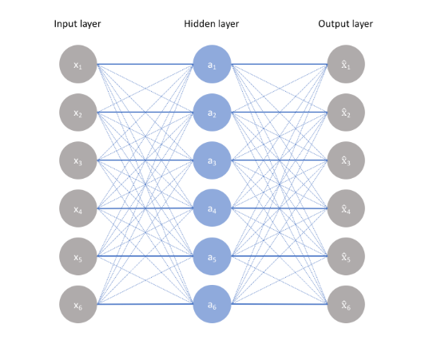

Slide 6

The ideal autoencoder manages a trade-off between two things
Sensitivity to inputs to be able to create a reconstruction
Insensitivity to inputs to avoid memorizing the training data.
This involves constructing a loss function which is a representation error and a regularizer

Slide 7
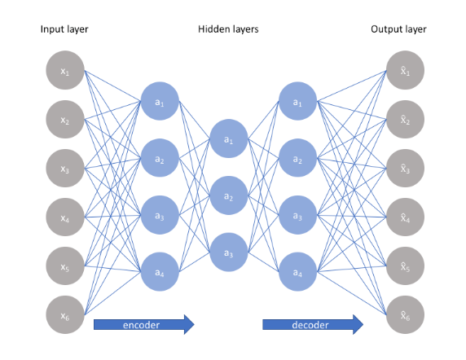

Slide 8
Because neural networks are capable of learning nonlinear relationships, this can be thought of as a more powerful (nonlinear) generalization of PCA.
Whereas PCA attempts to discover a lower dimensional hyperplane which describes the original data, autoencoders are capable of learning nonlinear manifolds (a manifold is defined in simple terms as a continuous, non-intersecting surface). The difference between these two approaches is visualized below.

Slide 9
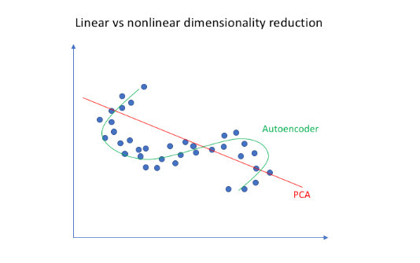

Slide 10
Sparse autoencoders
Sparse autoencoders offer us an alternative method for introducing an information bottleneck without requiring a reduction in the number of nodes at our hidden layers.
Instead of the bottleneck layer, we will introduce an artificial scarcity by learning encoding and decoding from a small number of neurons(spare autoencoding).
In the diagram of a generic sparse autoencoder, the opacity of a node corresponds with the level of activation.

Slide 11
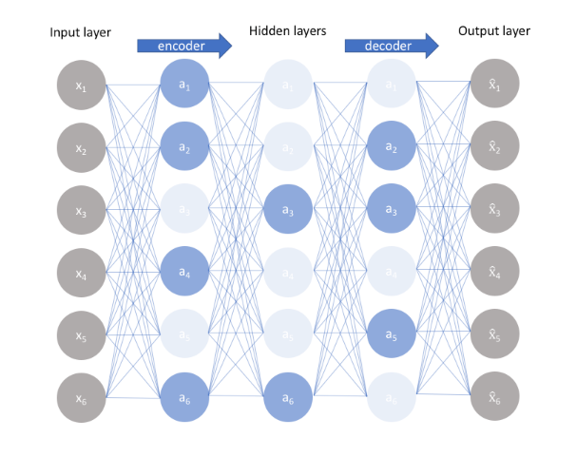

Slide 12
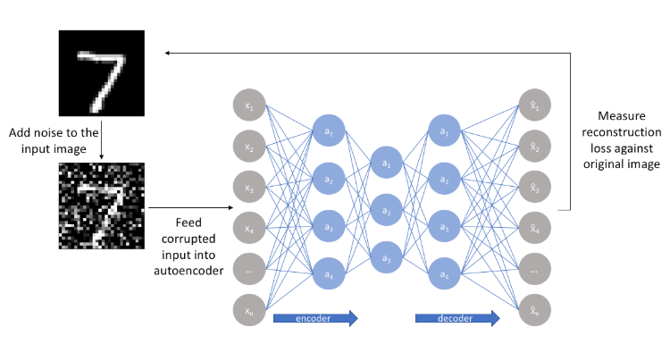
Denoising autoencoders
Another approach towards developing a generalizable model is to slightly corrupt the input data but still maintain the uncorrupted data as our target output.

Slide 13
The core idea here is: the manifold accurately captures the natural data and in doing so, we've effectively "canceled out" the added noise i.e. we have retained the salient portion of the input

Slide 14
Summary
An autoencoder is a neural network architecture capable of discovering structure within data in order to develop a compressed representation of the input.
Many different variants of the general autoencoder architecture exist
Their goal is to ensure that the compressed representation represents meaningful attributes of the original data input;
Typically the biggest challenge when working with autoencoders is getting your model to actually learn a meaningful and generalizable latent space representation.

Slide 15
Variational autoecoders

Slide 16
Variational Autoencoders (VAEs) extend the idea of the autoencoder to create a powerful generative mechanism for producing synthetic content(fake human faces, synthetic music etc)
Remember that generative models create a new output that looks similar to the input data.
VAEs allow you to alter(hence the name variational) to the generated representation. We can see clearly with an example

Slide 17
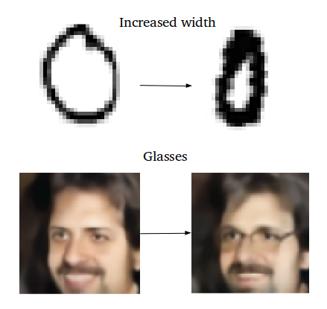

Slide 18
Remember that an autoencoder is actually a pair of two connected networks, an encoder and a decoder.
An encoder network takes in an input, and converts it into a smaller, dense representation, which the decoder network can use to convert it back to the original input.
The idea of encoding is actually more general i.e. a CNN is also an encoder (which captures the representation) and a classifier on top ex

Slide 19
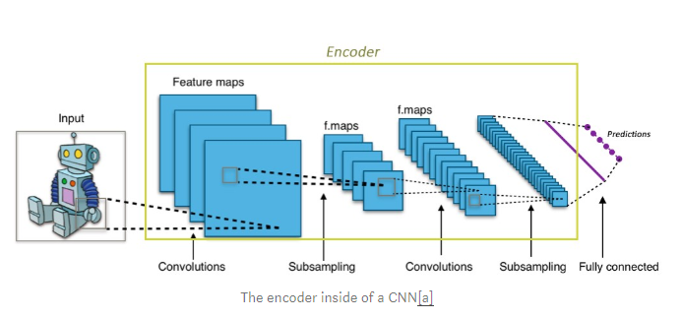

Slide 20
In the CNN, we take an image and convert it to a much more compact, dense representation (eg. rank 1 tensor of size 1000).
This dense representation is then used by the fully connected classifier network to classify the image.
Similarly, the autoencoder, the network that takes in an input and produces a much smaller representation (the encoding),
The encoding contains enough information for the next part of the network to process it into the desired output format.

Slide 21
Typically, the encoder is trained together with the other parts of the network(ex: the decoder) and optimized via back-propagation, to produce encodings that are useful for the task at hand.
In CNNs, that task is the encodings produce a representation that is useful for classification.
So, for autoencoders, we make the encoder generate encodings that are useful for recreating its own input.

Slide 22
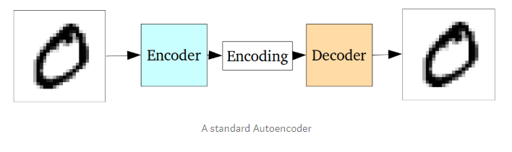
The network is trained as a whole.
The loss function is usually either the mean-squared error or cross-entropy between the output and the input, known as the reconstruction loss
The reconstruction loss penalizes the network for creating outputs different from the input.

Slide 23
You can think of the encoding as the output of the hidden / intermediate layer – except that it has less layers than the input layer (in comparison to the MLP)
Because of the limit on encoding, the encoder learns to preserve the salient information. The decoder learns to take that compressed information and reconstruct the full image

Slide 24
In autoencoders, the latent space may not be contiguous to allow for easy interpolation.
The latent space is the area between the encoder and the decoder.
If latent spaces are contiguous, it allows for easy random sampling and interpolation.
Interpolation is a type of estimation, a method of constructing new data points within the range of a discrete set of known data points
Variational autoencoders (VAE) provides a probabilistic manner for describing an observation in latent space.
In VAE, the encoder describes each latent variable as a probability distribution instead of a static value.

Slide 25
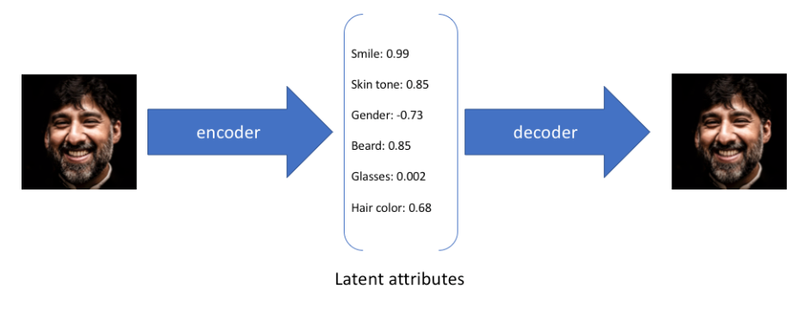
For the above input image, each latent variable is described in terms of a single value. In contrast, for the next image, each latent variable is described as a probability distribution.

Slide 26
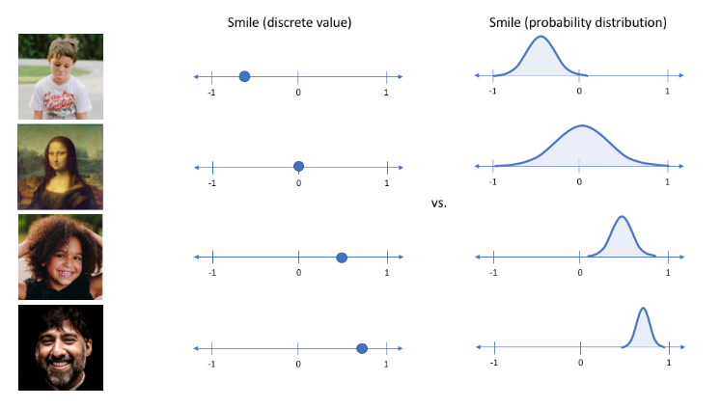

Slide 27
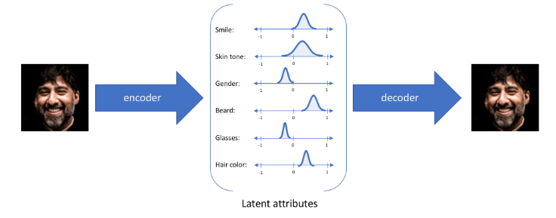
With this approach, we'll now represent each latent attribute for a given input as a probability distribution. When decoding from the latent state, we'll randomly sample from each latent state distribution to generate a vector as input for our decoder model.

Slide 28
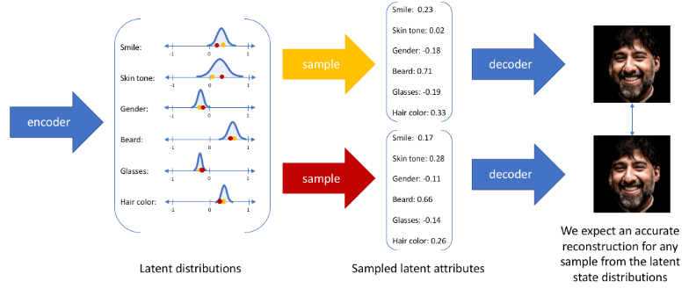

Slide 29
Applications of autoencoders include:
Anomaly detection
Data denoising (ex. images, audio)
Image inpainting
Information retrieval

Slide 30
Sources
https://www.jeremyjordan.me/variational-autoencoders/
https://towardsdatascience.com/intuitively-understanding-variational-autoencoders-1bfe67eb5daf

Slide 31
Videos
https://www.youtube.com/watch?v=Rdpbnd0pCiI
https://www.youtube.com/watch?v=b9COD6To5LM
Sources: Introduction to autoencoders – by Jeremy Jordan

Slide 32
